Slide 1
SWIFT RAILS- Data Flow-S2
Owner: Harsha
Contributor:Priya
Peer-Reviewer: Sankeerth

Slide 2
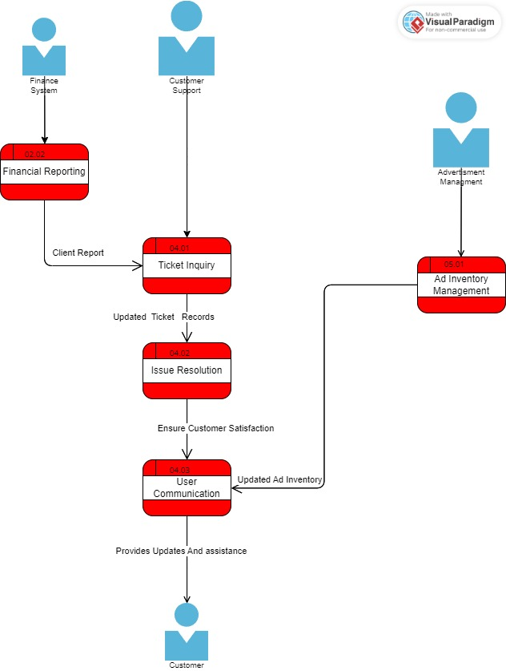
SwiftRails-Logical -s2

Slide 3
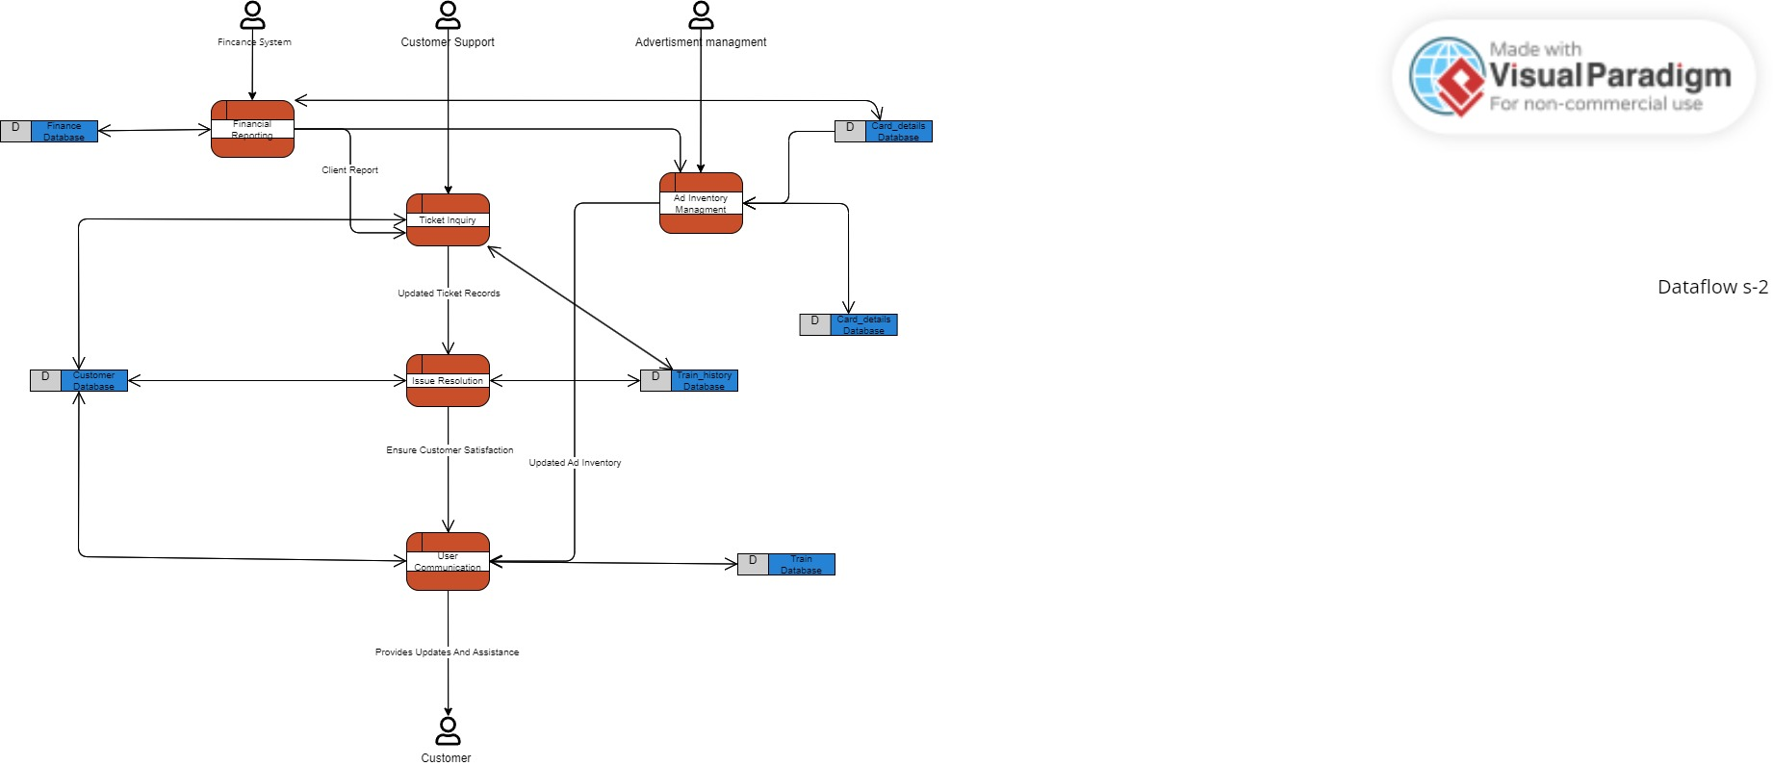
Swift Rails- Physical-s2

Slide 4
SPRINT-2
Core Feature | Scope
02.02 Financial reporting | Generates reports summarizing financial data, transactions, and performance for analysis and decision-making.
04.01 Ticket handling inquiry | Manages customer inquiries related to ticket bookings, event details, or general information through a ticketing system.
4.02 Issue resolution and refunds | Handles the resolution of customer issues, including processing refunds when necessary, to ensure customer satisfaction.
04.03 User communication | Facilitates communication with users, providing updates, information, and assistance through various channels.
05.01 Ad inventory management | Manages the inventory of available advertising spaces on the platform, ensuring effective placement of ads.

Slide 5
SWIFT RAILS- Data Flow-S3
Owner: Harsha
Contributor:Priya
Peer-Reviewer: Shasank

Slide 6
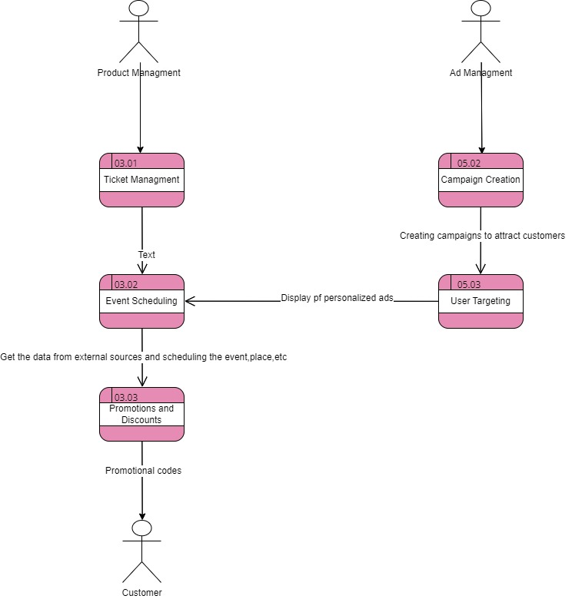
SwiftRails-Logical -s3

Slide 7
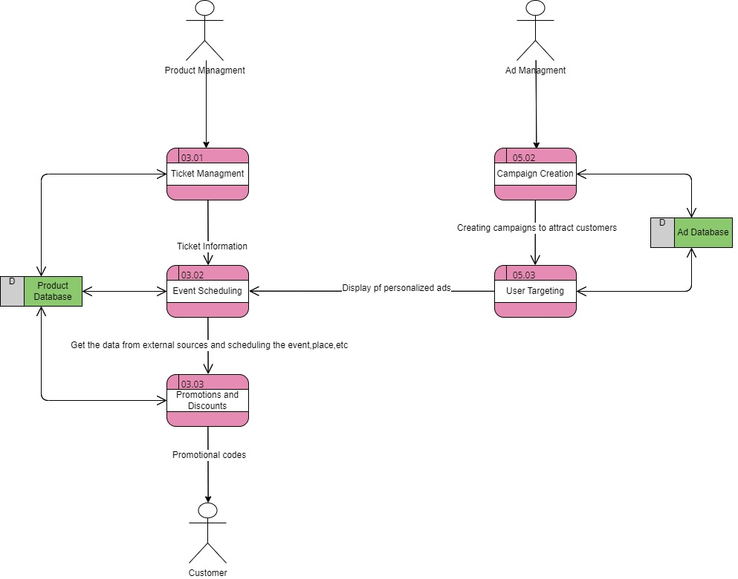
Swift Rails- Physical-s3

Slide 8
SPRINT-3
Core Feature | Scope
03.01Ticket Inventory Management | Handle data retrieval and display errors gracefully to provide users with up-to-date ticket information. Dfin - data flow in.
03.02 Event Scheduling and Planning | Handle data retrieval from external sources securely and efficiently to display train schedules and event plans accurately. Siout - system interface -Outbound
03.03 Promotions and discounts | Provide feedback for invalid or expired promotional codes and discounts entered by users. FV - Field validation
05.02 Campaign creation and monitoring | Create campaigns to attract customers by showing promotional ads
05.03 User targeting personalize | Ensure accurate data retrieval and display of personalized ads to target the right audience effectively. Siout - system interface - outbound

